Slide 1
BPSCCA Y5/Y6 cross-country event at Crystal Palace Park
Saturday, 14th November 2026

Slide 2
Entry Procedure…
Complete the application form (both pages, please):
  First page: put in the race fees (which can be calculated from the invitation letter)
  Second page: be sure to include a contact e-mail address (clearly, please), the name of the teacher in charge on the day and the emergency contact phone number…these details need to be updated if there are subsequent changes.
Copy the form:
  Pass a copy to your finance department. Point out the payment date and, also make clear that we do not provide invoices.
  Return the application form, by post (address on form) or email to cwaring7@gmail.com asap!!! Do it today.

Slide 3
Travel/Parking…
Consider using public transport.
If driving, leave home early.
There will be no free parking in the park.
Suggest to parents that they park in neighbouring roads.
Bring up the idea of car sharing, where possible.
If you or a colleague/parent have a marshalling responsibility, then it is vital that you or they are on time.
Set up starts from 7am and the marshals’ meeting will be at 8.30am.

Slide 4
Marshalling
Suggestions for new Team Managers. A minimum of three people is needed to help with the team on the day:
  A person to collect children at the Meeting Point.
  A person to be with the children at the start line.
  A person to write down the children’s names and places at the finish and take the children back to the meeting point.
  Each school also needs to supply marshals. Small schools one, medium schools, ideally, two and large schools three.
  If schools are finding it hard to get staff, please consider helping to set up before or clear away after the event where the staff helping with the team during the event can be the same. Schools that help in this way do not need to supply marshals making it easier to find enough staff especially for small schools.

Slide 5
Some Health and Safety Points
Medical support will be on site to deal with any injuries you cannot manage yourselves.
A medical form for your runners will need to be completed and must be handed in when you arrive on race day…(see next slide)
Please ensure you deal with any individual medical needs of children in your teams e.g. children carrying an asthma pump where required (marked with parent/guardian contact phone number).
The medical team will contact the school’s listed contact to report any injuries out on course which they will then deal with – please ensure your contact numbers are up to date and ready to answer if needs be.
The school is responsible for informing parents of any injuries being dealt with.
You are responsible for your school’s children on site i.e. whilst waiting for races and before being returned to parents.
Our ‘hares’ will lead the way for the children and ensure all children complete the course.

Slide 6
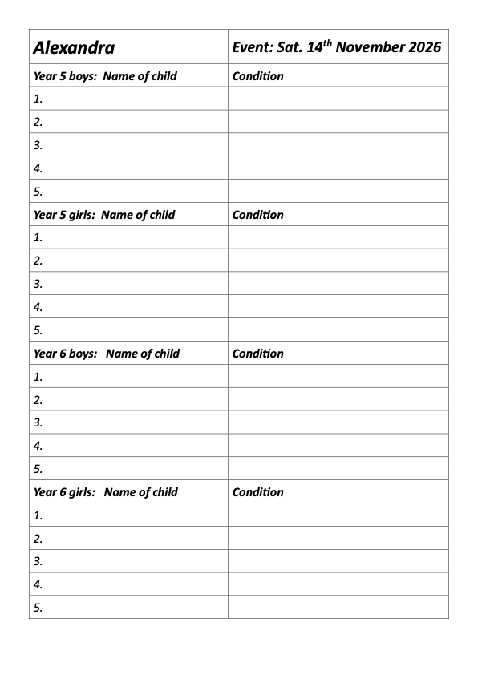
Medical Form

Slide 7
Some Health and Safety Points
Children should wait in the holding area after the race with their staff member and only leave the holding area with the member of staff when the all runners from the school team have gathered. No parents will be able to access this holding area.
In the case of an emergency, it will be announced that children return to the meeting points from where further instructions will be provided and your children can be accounted for.
In the case of a race in progress, marshals will be instructed to hold runners at their respective point and then to return to the finish with the children unless advised to wait at the muster point to which further instructions will be provided.
Additional instructions will be announced if it is necessary to evacuate the park.
Finally, in the words of British Rail: “See it. Say it. Sorted.”

Slide 8
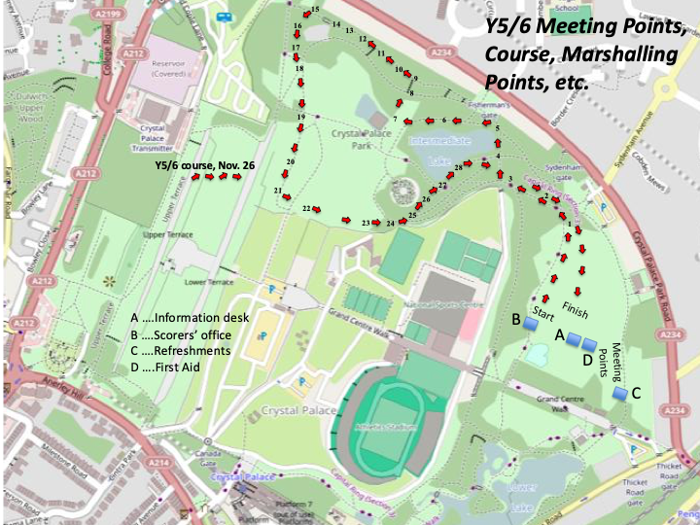
Course

Slide 9
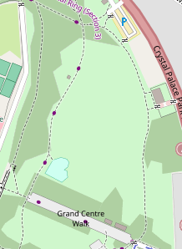
Toilets
Meeting
Points
Refreshments
Finish
Recording
Area
First Aid
Info. Desk
Starting Pens
Scorers

Slide 10
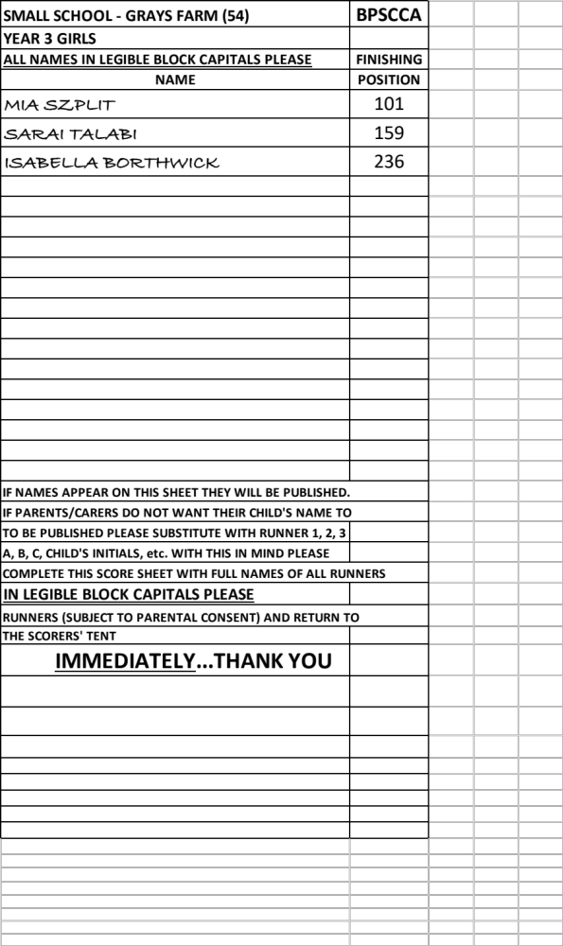
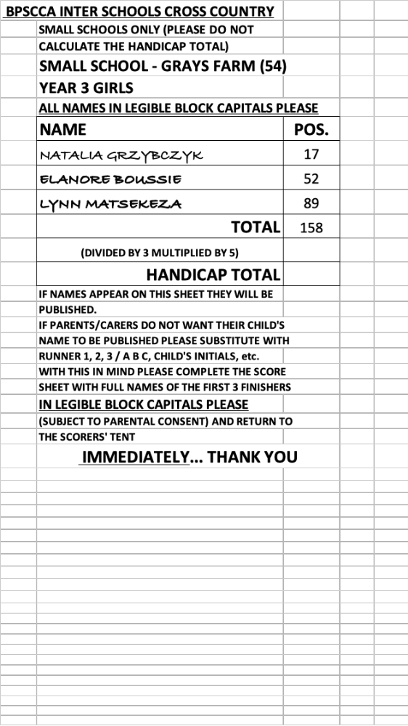
Scoring

Slide 11
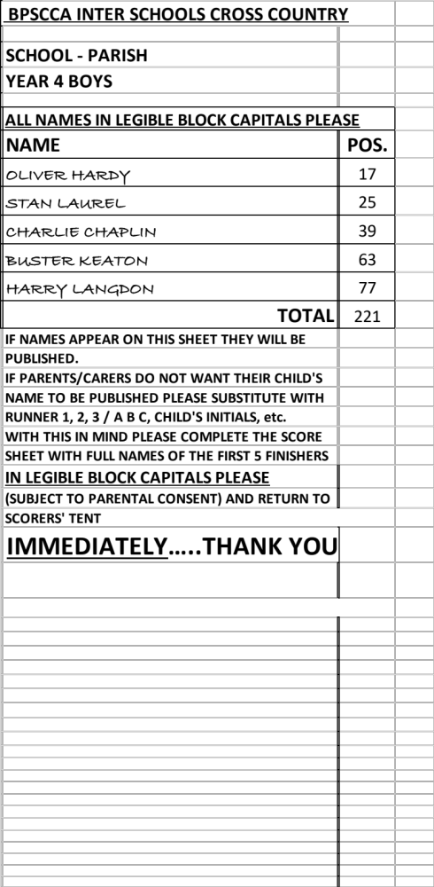
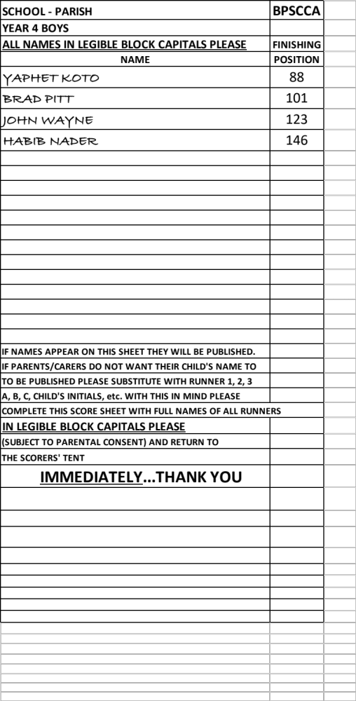

Slide 12
Thank You!
Crystal Palace Park Trust
Blackheath and Bromley Harriers
Park Run
ersg
The medical team (EMFS)
Eat Fresh
Farringtons
The Bromley Mayoral team
All volunteers
All schools participating

Slide 13
Lastly…
For almost all questions, please refer to the website:
www.bpscca.co.uk
otherwise, contact:
info@bpscca.co.uk

